Slide 1

Lunch and Learn: Geospatial Analysis
Booz Allen Hamilton INC. internal
Women in Data Science Incubator: Cohort 4
JUNE 2021

Slide 2
PURPOSE of this presentation
Vector DATA vs. Raster data
Datums vs. projections
Types of spatial files
Visualization tips & Types of Maps
Using R AND PYTHON GEOSPATIALLY

Slide 3
Purpose of this presentation
Provide the ‘basics’ of geospatial data preparation/usage from an open-source/coding-first perspective.
At the end of this presentation, you should have a basic familiarity with:
Geospatial presentations and formats
How to visualize geographic data and types of maps
Packages (R) or modules (Python) that can process geospatial data and produce compelling visualizations

Slide 4
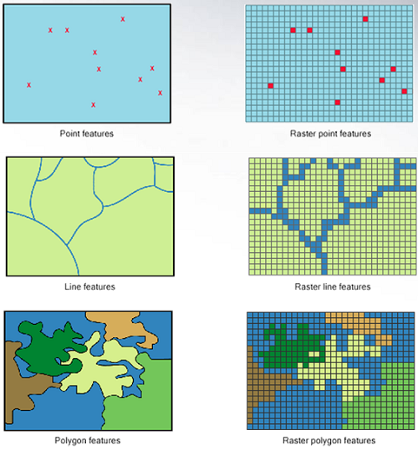
Vector data vs. raster data
http://gsp.humboldt.edu/OLM_2017/Lessons/GIS/08%20Rasters/RasterToVector.html
Notes:
Vectors represent specific features, with assigned attributes to each feature. They have distinct geometries, with distinct vertices and paths. They can take the form of points/lines/polygons. Behind the scenes, each of these entities can have its own metadata associated with it – which we’ll handle later with geopandas.
Rasters are gridded data, where each pixel is treated as a separate, spatial encapsulation of data at a particular point in space. With raster data, the metadata often cannot be ‘tied’ to any particular feature.
In the graphic here, we have a graphical comparison between vector data (the points/lines/polygons on the left-hand side) and raster data (where the data for each particular point is ‘gridded’ into space).

Slide 5
Datums vs. Projections

Slide 6
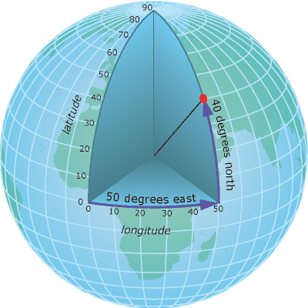
Datums vs. projections: Datums
https://www.earthdatascience.org/courses/use-data-open-source-python/intro-vector-data-python/spatial-data-vector-shapefiles/geographic-vs-projected-coordinate-reference-systems-python/
Notes:
A datum is defined as a set of reference points on the earth’s surface, against which position measurements are made. For the purposes of a geographic coordinate system, a datum is based on an ovoid model, known as a reference ellipsoid. A datum can be thought of as a ‘modeled sphere of the earth’.
In order to delineate a location on a datum, a geographic coordinate system is often used. These are coordinate systems that span the entire globe. These are often measured in latitude and longitude, respectively, which are colloquially known as “lat and long”, although other types of measurements exist.

Slide 7
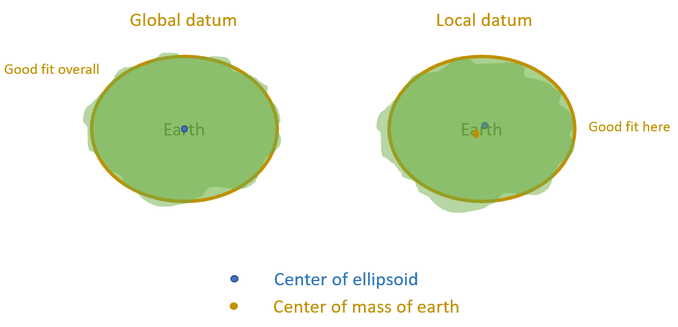
Datums vs. projections: wgs84
https://support.virtual-surveyor.com/en/support/solutions/articles/1000261330-what-is-a-horizontal-datum-
Notes:
The most current version of the global datum is known as the World Geodetic System 1984, or WGS84 for short. It’s known as a global datum, as in it has a relatively good fit according to the earth’s system overall. However, there are also what is known as a local datum – where there is a good fit to a very small (local) area, but it will not approximate the rest of an area.

Slide 8
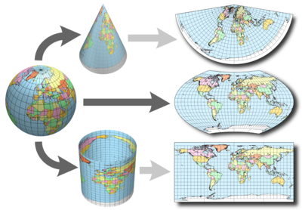
Datums vs. projections: PROJECTIONS
https://www.earthdatascience.org/courses/use-data-open-source-python/intro-vector-data-python/spatial-data-vector-shapefiles/geographic-vs-projected-coordinate-reference-systems-python/
Notes:
Geographic coordinate systems (which are often but not always in decimal degree units) are often optimal when you need to locate places on the Earth. Or when you need to create global maps. However, latitude and longitude locations are not located using uniform measurement units. Thus, geographic CRSs are not ideal for measuring distance. This is why other projected CRS have been developed.
A projected coordinate systems is a coordinate system that is localized to minimize visual distortion in a particular region (e.g. Robinson, UTM, State Plane).
Spatial projection refers to the mathematical calculations performed to flatten the 3D data onto a 2D plane (your computer screen or a paper map). Projecting data from a round surface onto a flat surface, results in visual modifications to the data when plotted on a map. Some areas are stretched and some are compressed. You can see this distortion when you look at a map of the entire globe.
The mathematical calculations used in spatial projections are designed to optimize the relative size and shape of a particular region on the globe. A projection can preserve area, shape, length, or angle.
With spatial imagery, usually can use standard such as EPSG (EPSG Geodetic Parameter Dataset (also EPSG registry)) or proj4 strings

Slide 9
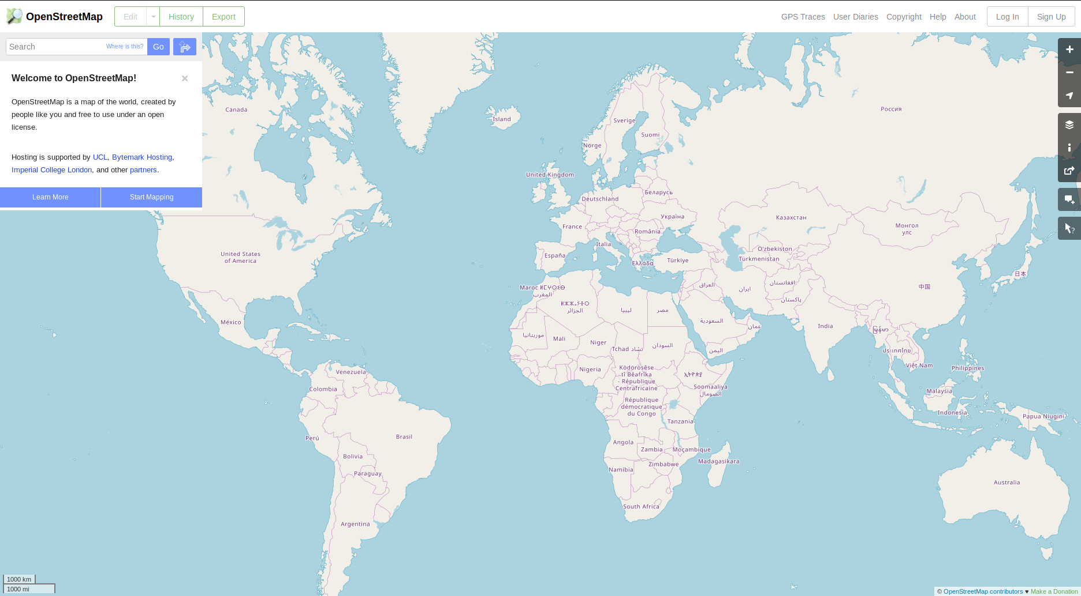
Datums vs. projections: WEB MERCATOR
https://openstreetmap.org/
Notes:
Web Mercator maps are most known as the map format used by most web maps, and the format obtained most readily from APIs. Examples can include Google Maps, Apple Maps, OpenStreetMap, MapBox, MapQuest, or ESRI.
Mercator projections, generally, are what are called equal-angle projections. However, the Web Mercator differs from a traditional Mercator projection by using a sphere (not an ellipsoid) as its underlying datum. While this projection’s coordinates can be output as a lat-long, there are significant discrepancies in coordinates as one moves away from the equator – and can be up to 40 kilometers at the poles.

Slide 10
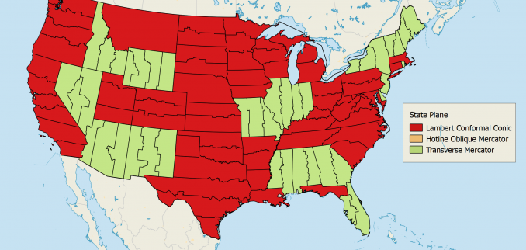
Datums vs. projections: State Plane
https://gisgeography.com/state-plane-coordinate-system-spcs/
Notes:
The State Plane Coordinate System (SPCS) is a set of 124 geographic zone coordinate systems that are based for specific regions of the U.S.. Primarily used by state and local data, it uses a simple Cartesian coordinate system to speed up and sample calculators. Each system is specifically accurate within a particular zone – but is not as accurate outside of that zone’s geographical boundaries.
In the diagram seen here, we see the zones used by the continental U.S.. Additionally, there are 10 zones available in Alaska, and separate zones for each Hawaiian island.
Coordinates here use a system known as northings (for y-oriented data) and eastings (for x-oriented data), and can be specified in survey feet.
On average, zones that are north-south oriented use a transverse Mercator system, while zones that are east-west oriented use a Lambert conformational conic projection.

Slide 11
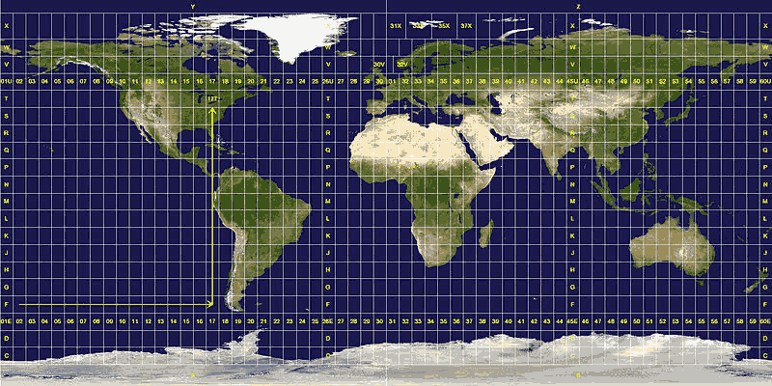
Datums vs. projections: UniversAL Transverse Mercator (UTM)
http://geokov.com/education/utm.aspx
Notes:
UTM splits the earth into 60 zones, and projects to each zone as a basis for its coordinates. Each zone spans 6 degrees of longitude, and each as a designated central meridian. Like in the state plane system, there is the highest accuracy of coordinates within each zone, with accuracy rapidly decreasing outside of the zone. A Mercator projection, individualized to each zone, is then used to project the coordinates. The units used in this projection are in meters. This mapping system is used more for worldwide or international mapping.
https://en.wikipedia.org/wiki/Universal_Transverse_Mercator_coordinate_system

Slide 12
TYPES OF SPATIAL FILES

Slide 13
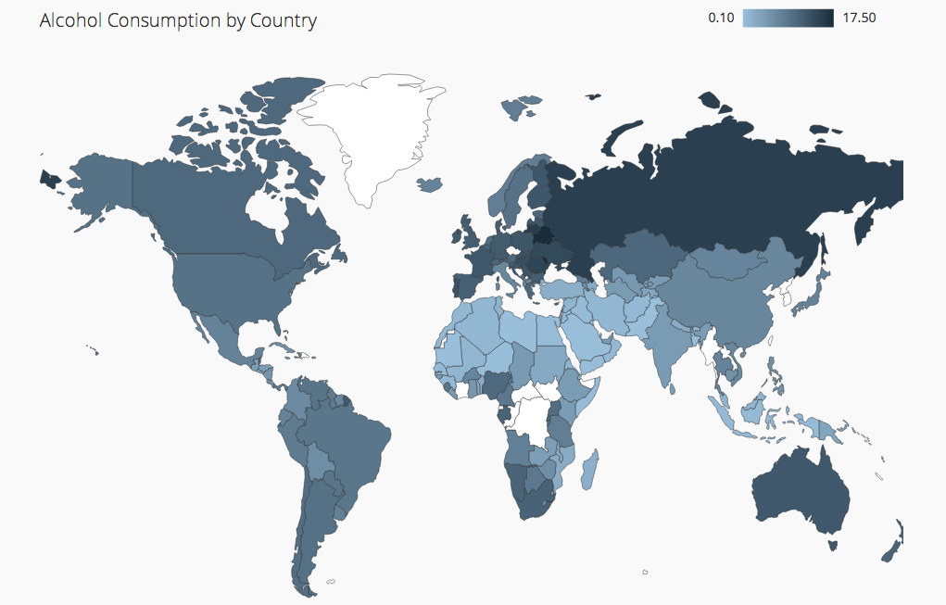
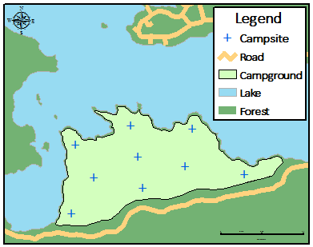
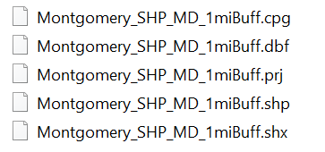
Types of spatial files: shapefiles
https://docs.safe.com/fme/2018.0/html/FME_Desktop_Documentation/FME_ReadersWriters/esrishape/esrishape.htm
https://www.sqlshack.com/create-geographic-maps-power-bi-using-built-shape-maps/
Notes:
ESRI-proprietary format for vector data
Used in most GIS software (ArcGIS, QGIS, etc.)
As output by most programs, SHP files consists of 5 files that get moved together as a single shapefile*
CPG: can indicate codepage/characterset
DBF*: database format (dBASE) table containing attribute information
PRJ: projection
SHP*: geometry
SHX*: index file containing indices of geometry
Note: if you remove one of the asterisked files, the shapefile may not work as intended!
Many examples of files can be found in https://desktop.arcgis.com/en/arcmap/10.3/manage-data/shapefiles/shapefile-file-extensions.htm

Slide 14
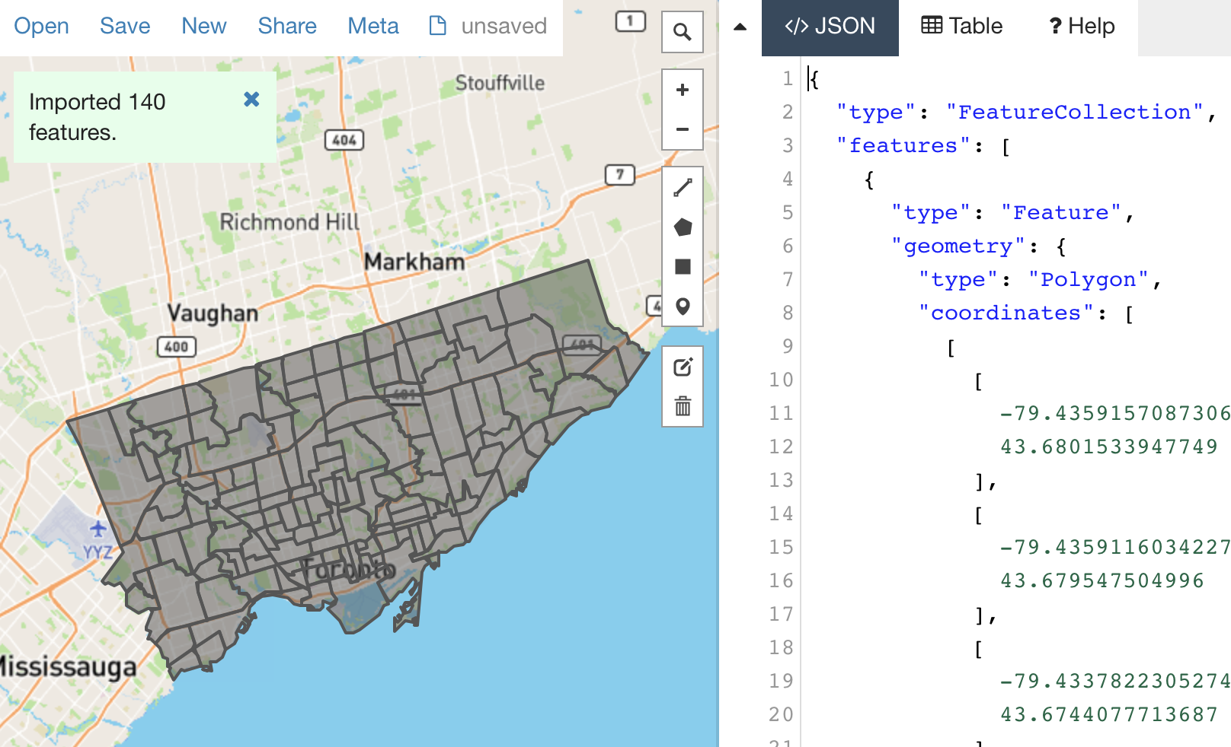
Types of spatial files: GEOJSON
https://handsondataviz.org/geojsonio.html
Notes:
Open standard format, based on the JSON format, represents simple geographic features and non-spatial attributes, often able to be extracted from an API
Designed for representing either vector features (points/lines/polygons/multipart features) or non-physical features (e.g., service coverage)
TopoJSON – GeoJSON that encodes topologies
Can be worked with in the same way as SHP
var geojsonFeature = {
"type": "Feature",
"properties": {
"name": "Coors Field",
"amenity": "Baseball Stadium",
"popupContent": "This is where the Rockies play!"
},
"geometry": {
"type": "Point",
"coordinates": [-104.99404, 39.75621]
}
};

Slide 15
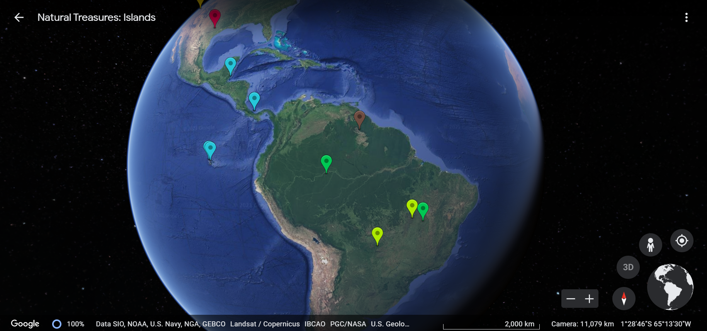
Types of spatial files: Keyhole Markup Language (ZIPPED) (KML/KMZ)
https://earth.google.com/web/@-1.47965276,-65.22526919,-726.24351377a,11080155.25408387d,35y,0h,0t,0r/data=CiQSIhIgYmFlNzAyMjgwNTE4MTFlNzlmYmFhYjg0NThhYTgzNjQ
Notes:
Keyhole Markup Language (KML) is a file format used to display geographic data in an Earth Browser
Open standard used by Open Geospatial Consortium
Compressed archive KML file is called Keyhole Markup Language Zipped (KMZ)

Slide 16
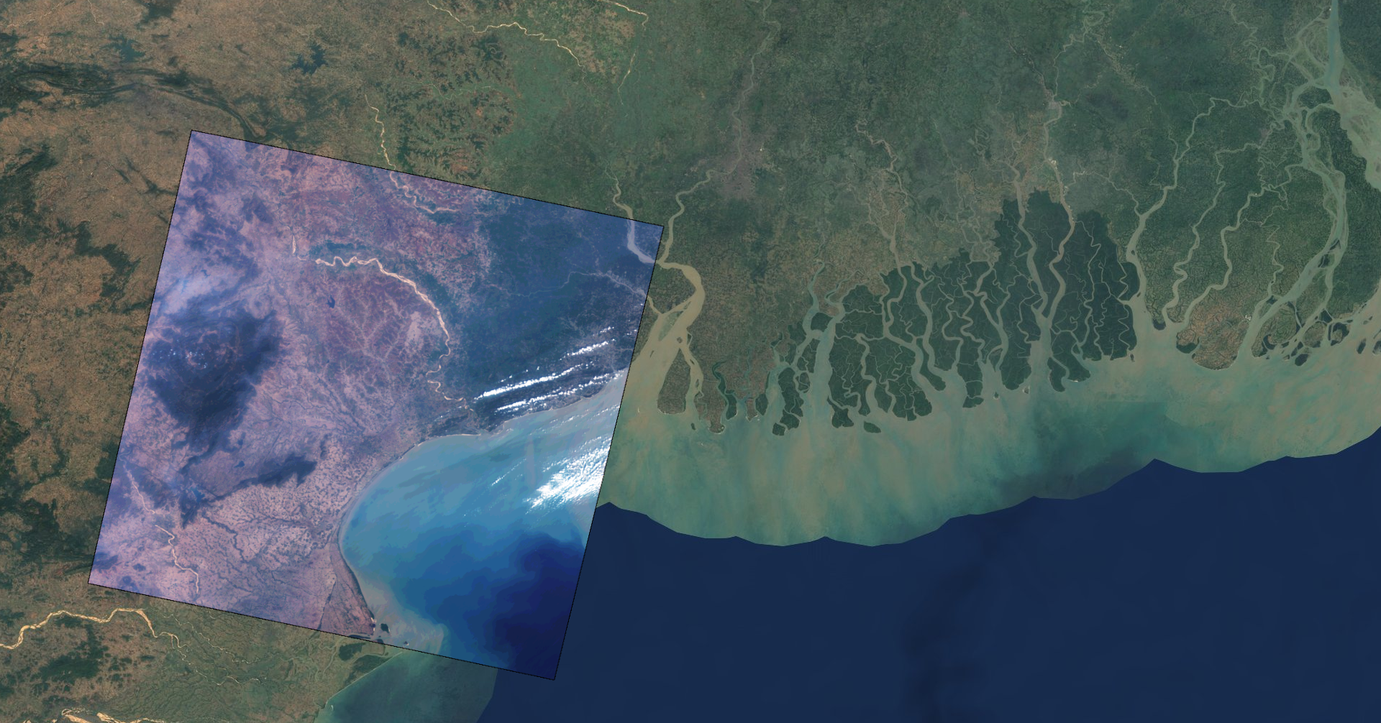
Types of spatial files: GEOTIFF
https://geotiffjs.github.io/
Notes:
Now that I’ve mentioned a few standards for handling vector data – those points, lines, and polygons – I’m now going to mention a few standards for handling raster data.
GeoTIFFS are a public domain metadata standard which allows georeferencing information (map projection, coordinate systems, ellipsoids, datums, and everything else necessary to establish the exact spatial reference for the file) to be embedded as metadata within a TIFF file. (Optional: TIFF is a flexible, adaptable file format for handling images and data within a single file, by including the header tags (size, definition, image-data arrangement, applied image compression) defining the image's geometry.)
GeoTIFFS are used to handle a lot of continuous raster-based – or ‘gridded’ – data. As such, you can find these on a lot on gridded formats, such as satellite imagery, digital elevation models (DEMs), land cover data, or precipitation estimates.
One of the other standards is NGA’s NITF standards, which is also used in many commercial imagery sources (e.g., Planet). Note that NGA basically has the commercial imagery contracts for the US gov (NASA Earth Science actually sources through NGA if it's not ours/NOAA/etc) https://gwg.nga.mil/ntb/baseline/documents.html
Perhaps the most important is: NITF file parsing is all standardized in Geospatial Data Abstraction Library (GDAL), so it's easy to hit the ground running.
How to handle rasters: https://datacarpentry.org/organization-geospatial/01-intro-raster-data/
Other forms of raster data formats: https://desktop.arcgis.com/en/arcmap/10.3/manage-data/raster-and-images/supported-raster-dataset-file-formats.htm

Slide 17
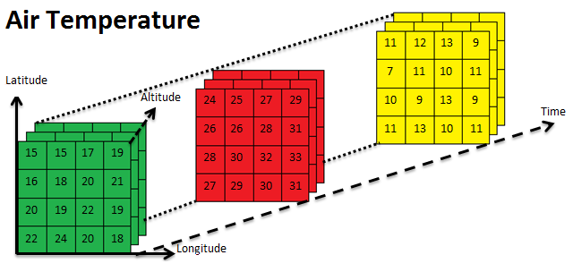
Types of spatial files: NETCDF
https://www.unidata.ucar.edu/software/netcdf/
Notes:
Network Common Data Form (NetCDF) is a self-describing, portable, scalable, and appendable, shareable, and archivable type of array-oriented scientific data. It can be interfaced with most data science platforms.
A NetCDF file is basically a multidimensional array – made of different variables, and potentially different dimensions for each variable. Within some geospatial circles, you can expect this format to be called a “time cube”. Most commonly within the geospatial circles, each array ‘layer’ can encode some continuous feature, and latitude and longitude. These layers can then be combined with a time dimension to show a change throughout time.
http://xarray.pydata.org/en/stable/

Slide 18
VISUALIZATION TIPS

Slide 19
Visualization tips: General
Metadata
Background Data Elements
Incorporate Map Elements
Symbolization
Labels & Legends
https://www.gislounge.com/ten-things-to-consider-when-making-a-map/
Notes:
Geographic Bounds – restrict only to extent of shown data
Background Data Elements – only add data that’s relevant or current to the map
Symbolization – color choices, line width, icons, labeling
Labels – use sparingly to identify important aspects
Legend –must be legible, not overly cluttered, easy to understand
Incorporating Map Elements – clear and concise title, notation for scale, north arrow
Metadata – document all sources of data, information helpful to viewer, map projection, datum used, authorship
Map Layout – map orientation (portrait vs. landscape), placement of map elements
Locator Map: include a smaller inset map if aimed at a larger audience
Peer Review: get another person to look at it

Slide 20
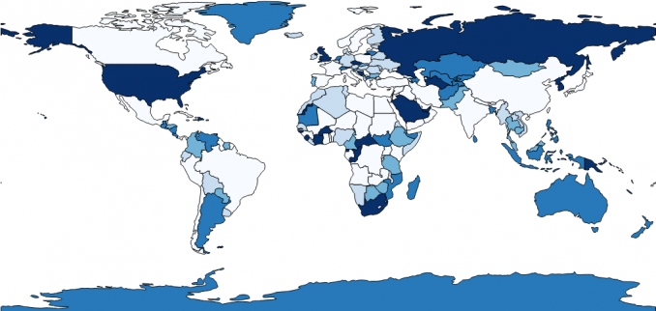
Visualization tips: Choropleth Map
Notes:
Now that I’ve talked a bit about some of the geospatial data formats, you’re wondering as a data scientist about how do I visualize this data? For the purposes of WiDS Incubator, I will touch upon two main use cases in my examples:
* Choropleth Maps
* Web-Based Maps
In general, choropleth maps are a type of colored-region map – where each area has a percentage or type of normalized data associated with it. These are used to shown derived quantities – density, average, rates, percents. (Choropleth maps represent quantitative data that is aggregated to areas (often called “enumeration units”). The units can be countries of the world, states of a country, school districts, or any other regional division that divides the whole territory into distinct areas.)
Ideally, these maps should have very few color categories – no more than 3-5 – for legibility. You’ll also see here that the colors are on a sequential gradient – where the darker the color, the higher the category – although divergent color schemes can also be used based on a midpoint of data.

Slide 21
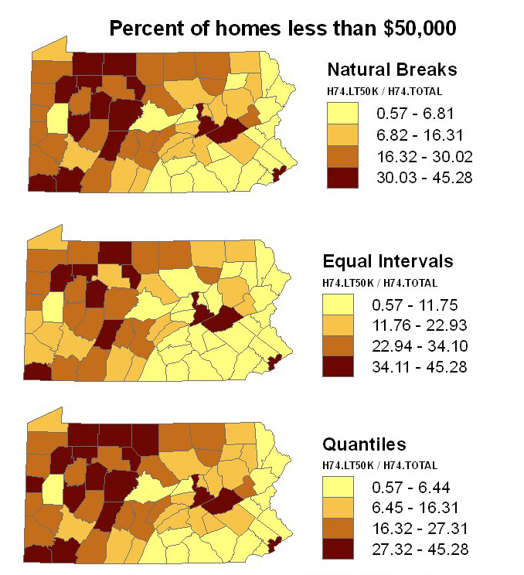
Visualization tips: Choropleth Map
https://gisgeography.com/choropleth-maps-data-classification/
Notes:
As a general rule, a choropleth map can be categorized in different ways. In the graphic above, natural breaks is the closest to a k-means classification, with maximum variance between groups and minimum variance within groups, an equal intervals map where each interval is different, and quantiles (which takes in each percentage of a group, e.g., quartiles).
https://gisgeography.com/choropleth-maps-data-classification/

Slide 22
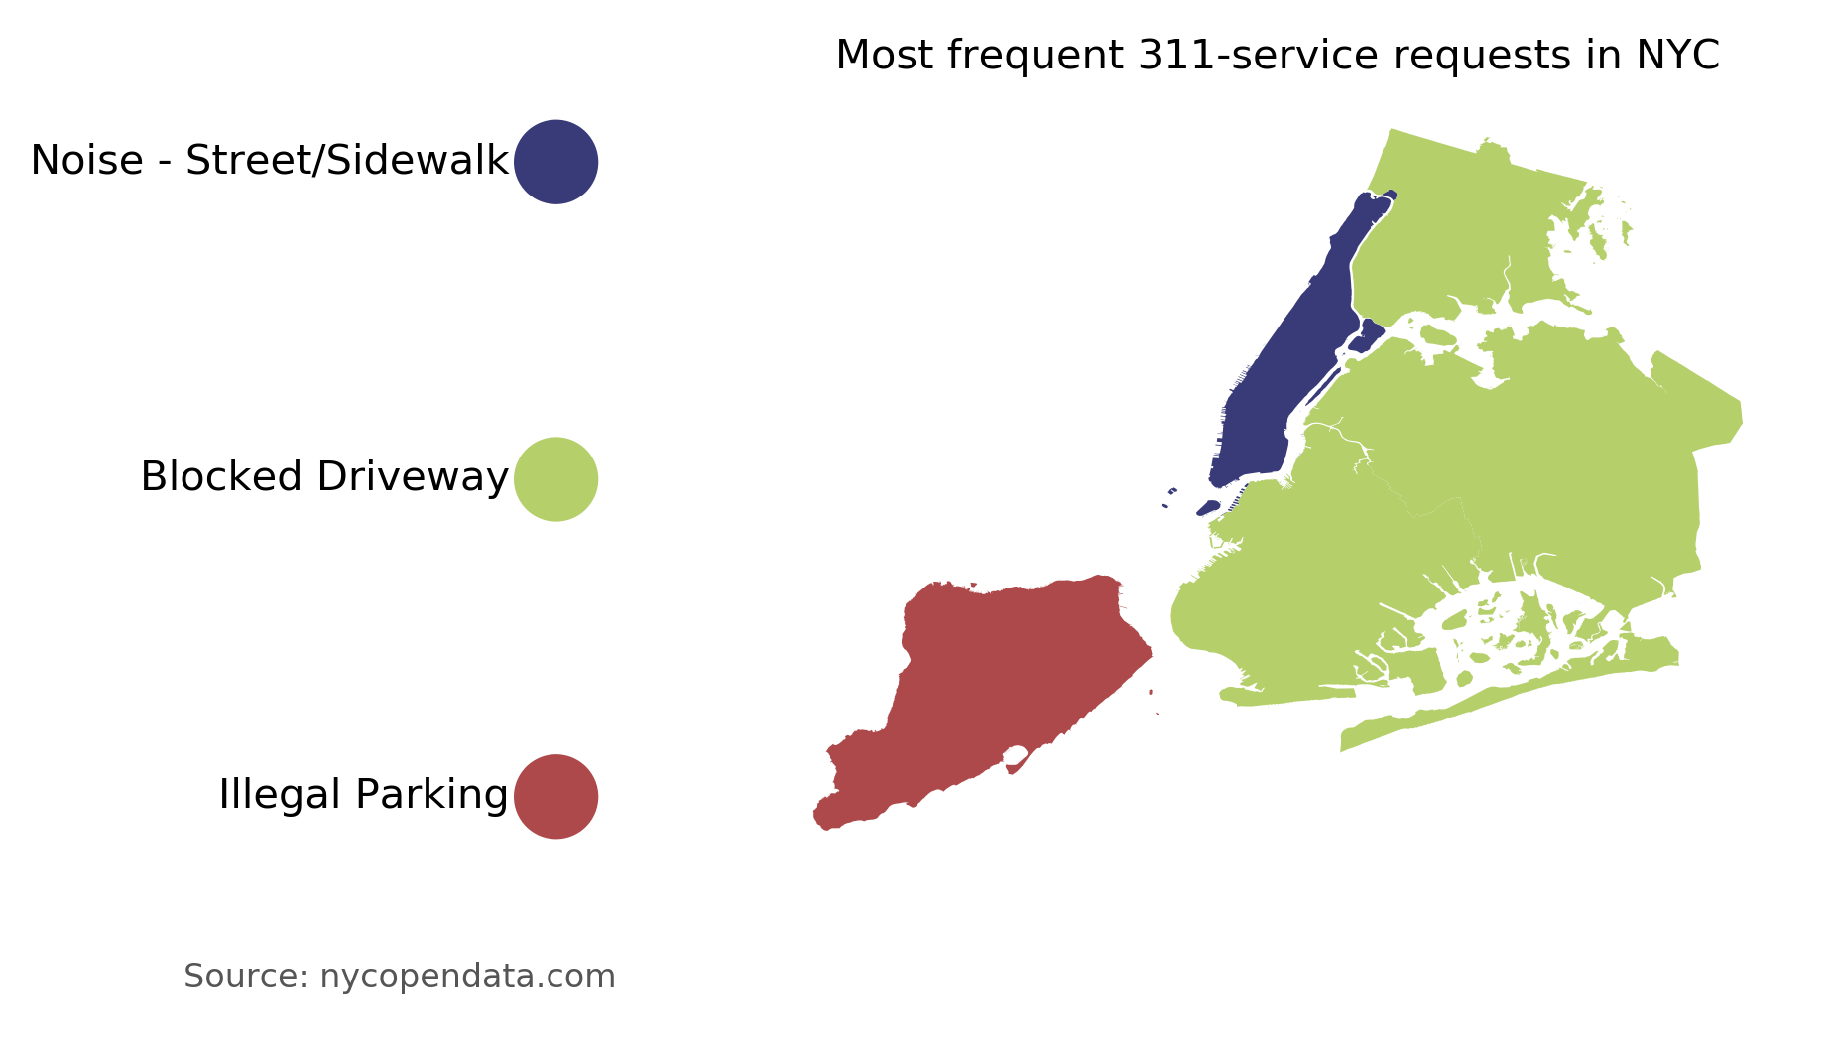
Visualization tips: THEMATIC MAP
https://towardsdatascience.com/create-categorical-choropleth-with-python-122da5ae6764
Notes:
In contrast, another type of map is a thematic, or categorical, map – which portrays a pattern of a particular subject matter (theme) in a geographic area. (The source I found here says categorical choropleth – and this isn’t technically correct.) You’ll see here that there is a clearly defined legend, and the colors are VERY discordant from here to emphasize separate categories.

Slide 23
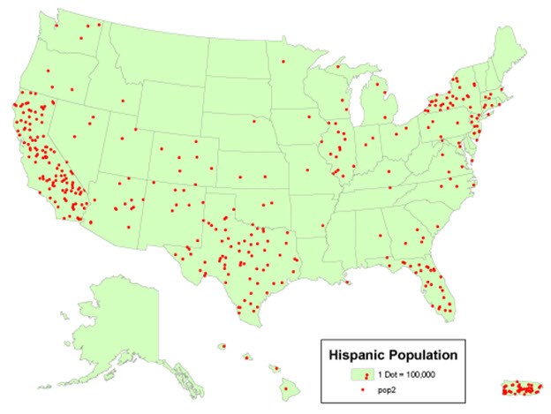
Visualization tips: Dot-Density MAP
https://www.e-education.psu.edu/geog160/c3_p14.html
Notes:
Dot density maps depict unaggregated count data at particular points. Each dot here symbolizes a certain entity – in this case, a population of 100,000 Hispanic individuals.

Slide 24
Using R and python Geospatially

Slide 25
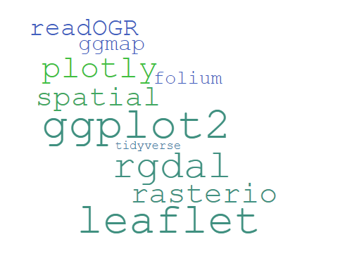
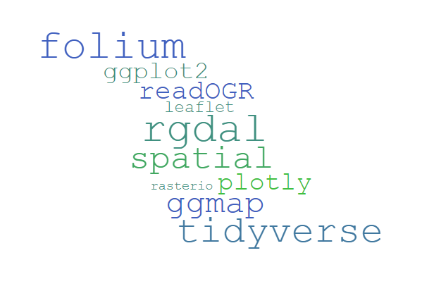
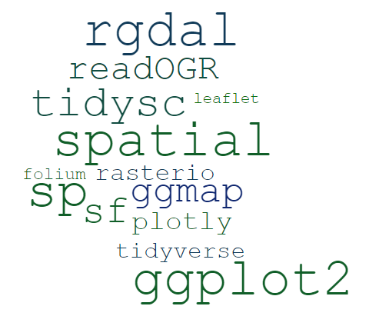
Using r geospatially
Notes:
spatial leaflet ggplot2 tidyverse ggmap rgdal rasterio readOGR folium plotly sp sf tidysc
Basic data viz: tidyverse, ggplot, ggmap
Reading spatial data: tidysc, spatial
Manipulation of spatial objects: sf, sp
Spatial Analysis: spatial (point pattern analysis/kriging)
Reading in KMLs/rasters: readOGR, rgdal
Using rasters: rasterio
Web mapping: leaflet, folium, plotly

Slide 26
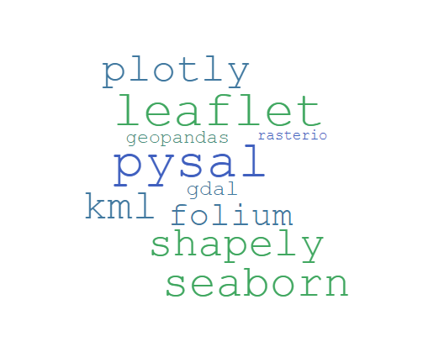
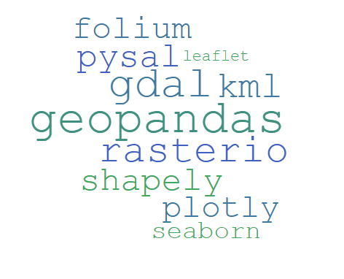
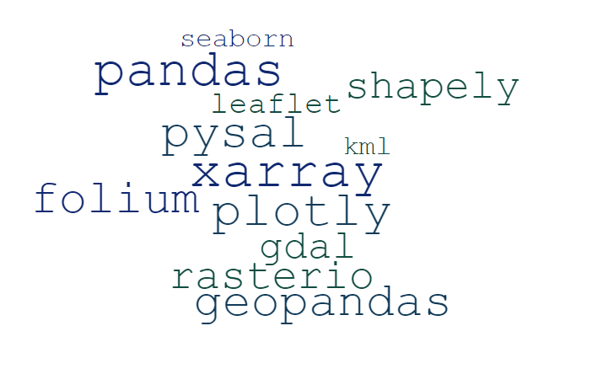
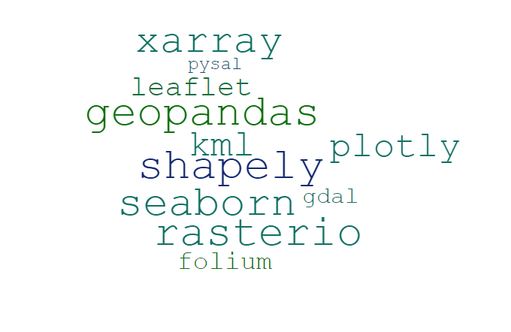
Using python geospatially
Notes:
Data science Python tools, particularly those dedicated to geospatial data (e.g. gdal, shapely, rasterio, geopandas).
gdal leaflet folium seaborn rasterio pysal plotly geopandas kml shapely xarray pandas
Basic data viz: pandas, geopandas, seaborn
Manipulation of spatial objects: gdal
Reading in spatial objects: shapely, xarray
Using rasters: rasterio
Web mapping: leaflet, folium, plotly

Slide 27
Additional Information
Data Carpentry’s Introduction to Geospatial Concepts
https://datacarpentry.org/organization-geospatial/
Google Earth Engine
Google Earth Engine Case Studies – examples of how Google Earth Engine is used by academics
https://earthengine.google.com/case_studies/
Google Earth Engine Collaboration Lab (CoLab) Setup directions
https://colab.research.google.com/github/google/earthengine-api/blob/master/python/examples/ipynb/ee-api-colab-setup.ipynb
Example datasets: https://developers.google.com/earth-engine/datasets/
Earth Lab
Analytics Hub courses
https://www.colorado.edu/earthlab/analytics-hub
Earth Data Science Workshops (which I think have virtual versions now)
https://www.colorado.edu/earthlab/earth-data-science-workshops
Example use cases of Earth Lab work in remote sensing
https://www.earthdatascience.org/tags/remote-sensing/
PyPi GeoJSON
https://pypi.org/project/geojson/
Notes:
For another time...
Census data (TIGR, ZIP vs ZCTAs)
Spectral data

Slide 28
Additional Information
Leaflet & GeoJSON
https://leafletjs.com/examples/geojson/
Create a “Categorical Choropleth” (actually, Thematic) map
https://towardsdatascience.com/create-categorical-choropleth-with-python-122da5ae6764
Penn State University, Thematic Maps
https://www.e-education.psu.edu/geog160/c3_p14.html
R Spatial (all R spatial vignettes)
https://r-spatial.org/
Quick Notes on All Projections (ESRI)
https://tinyurl.com/hu7n78kt
Haversine distances
https://www.movable-type.co.uk/scripts/latlong.html
CDC Cartographic Guidelines on Public Health (excellent cartographic resource)
https://www.cdc.gov/dhdsp/maps/gisx/resources/cartographic_guidelines.pdf
Mapping in Plotly (Python)
https://plotly.com/python/maps/

Slide 29
Questions?
Contact Michelle at:
Schmitz_michelle@bah.com
GitHub repository:
https://github.boozallencsn.com/Schmitz-Michelle/wids_geospatial_lunchnlearn

Slide 30
Extra Information

Slide 31
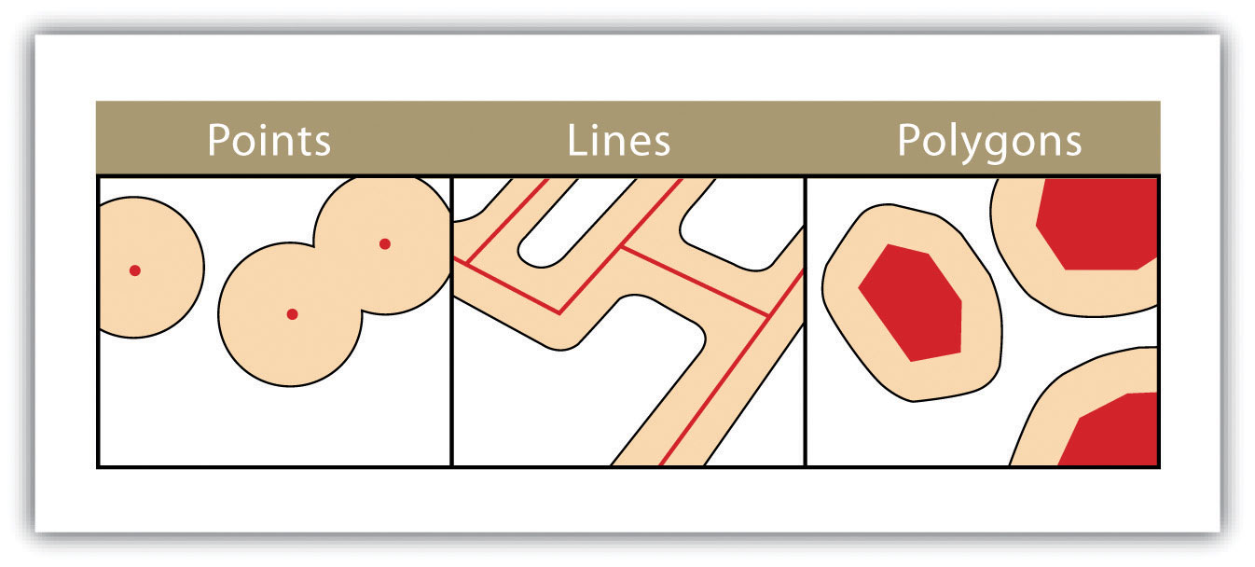
Basic Spatial Procedures: BUFFERS
https://saylordotorg.github.io/text_essentials-of-geographic-information-systems/s11-geospatial-analysis-i-vector-o.html
Notes:
Buffer analysis is the determination of a zone around a geographic feature containing locations that are within a specified distance of that feature, the buffer zone. I’ve included here a graphic that shows a buffer around points, lines, or polygons. (This is one type of what’s known as a proximity method.) In Python, this can be handled in geopandas.

Slide 32
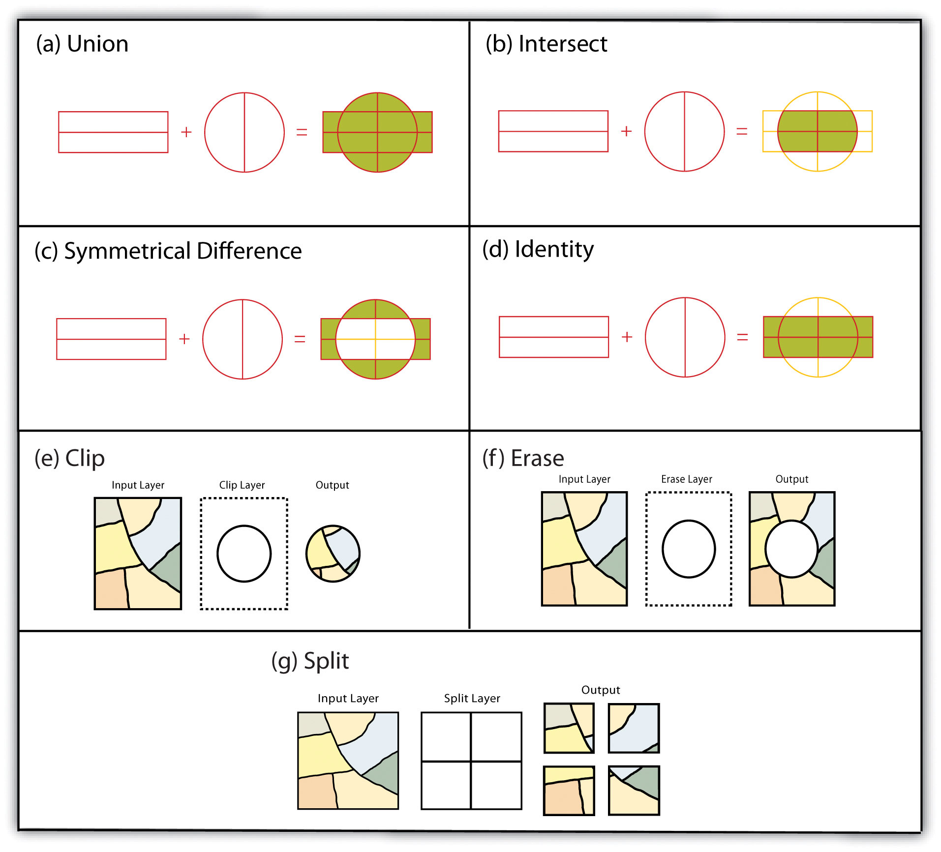
BASIC SPATIAL PROCEDURES: Overlay methods
https://saylordotorg.github.io/text_essentials-of-geographic-information-systems/s11-geospatial-analysis-i-vector-o.html
Notes:
There are also a series of overlay methods that I’ve included from this graphic – which basically uses different logical operators to either subset out different parts of overlaid vector files – union, intersect, symmetric difference, identity – as well as clip (which basically uses the ‘cookie cutter’ approach to clip out data), erase (the opposite of that) and split (which basically splits 1 vector entity by another vector entity)

Slide 33
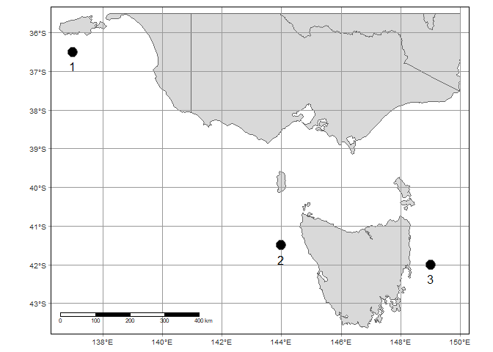
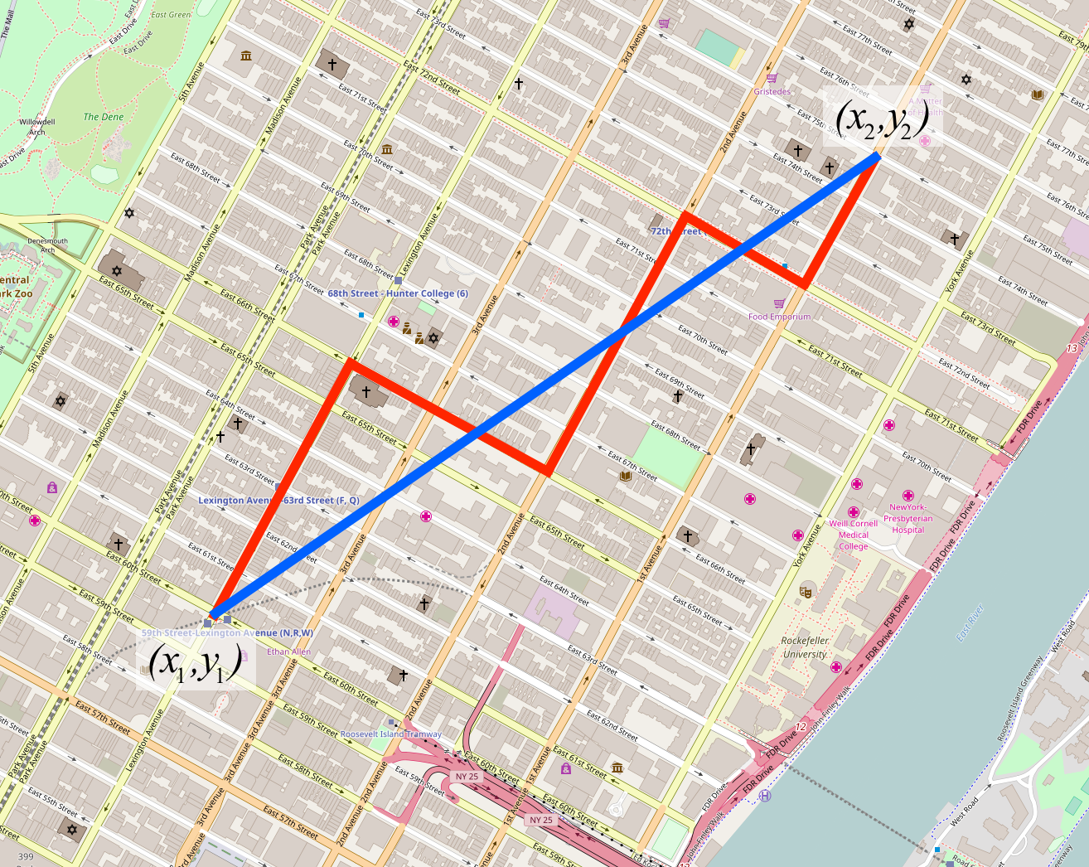
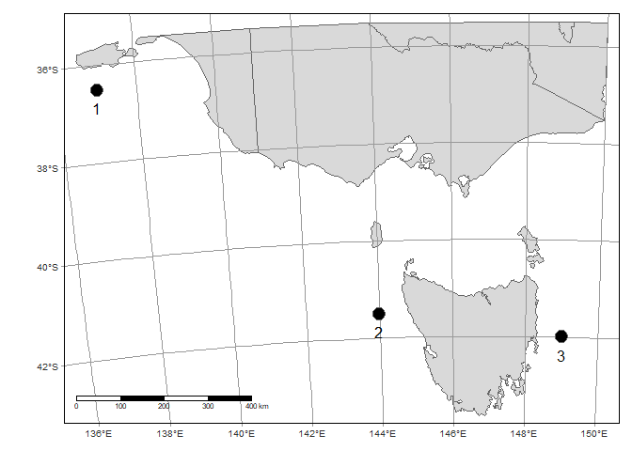
Basic Spatial Analyses: Distance calculations
https://subscription.packtpub.com/book/big_data_and_business_intelligence/9781787121515/3/ch03lvl1sec33/calculating-the-distance
https://www.r-bloggers.com/2020/02/three-ways-to-calculate-distances-in-r/
Notes:
Euclidean distance analyses are known as ‘straight-line distances’ or ‘as the crow flies’. At a smaller scale (i.e., projected data coordinate system), it should ideally be done after reprojecting data to an equal-distance (equidistant) projection (check out the ESRI Quick Notes in “Additional Information” on all projections).
Ideally, on a larger scale (and sometimes in a smaller scale – if the projections aren’t equidistant), distances calculations can be done with a haversine (great circle) distance – as long as it’s known that this is an approximation. This is close to WGS84, but usually uses a spherical datum on the backend.
In Python, geopandas can handle distance calculations, and haversines can be done with the haversine module (https://pypi.org/project/haversine/).
In R, sf can handle distance calculations, and haversines can be done with pracma (https://www.rdocumentation.org/packages/pracma/versions/1.9.9/topics/haversine).
Check this out for a good overview of all distance calculations and how they differ: https://www.r-bloggers.com/2020/02/three-ways-to-calculate-distances-in-r/

